Slide 1
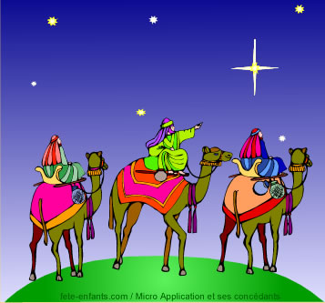
La Fête des Rois
le 6 janvier

Slide 2
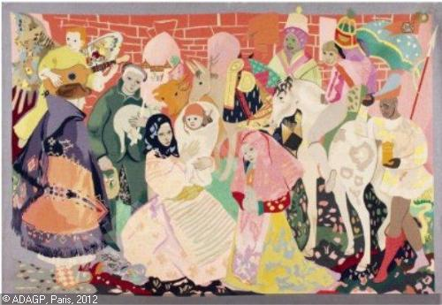
L’histoire
A merging of two ancient traditions
The Roman pagan celebration, "Les Saturnales" and
The Christian celebration of Epiphany: the arrival of the three wise men in Bethlehem.

Slide 3
Les Saturnales
During antiquity times (B.C.)
Week long festival which took place from December 17th to December 24^{th.}
Enjoyed huge feasts

Slide 4
Les Saturnales Cont’d
Represented a wish for prosperity, health and peace for all citizens.
Reverse traditional roles - masters would serve the slaves and they would eat together at the same table.
Small gifts to friends and family during the celebration. Oftentimes a small cake, which contained a small bean (la fève).
The person who found the fève in their slice of cake would be crowned king of the feast.

Slide 5
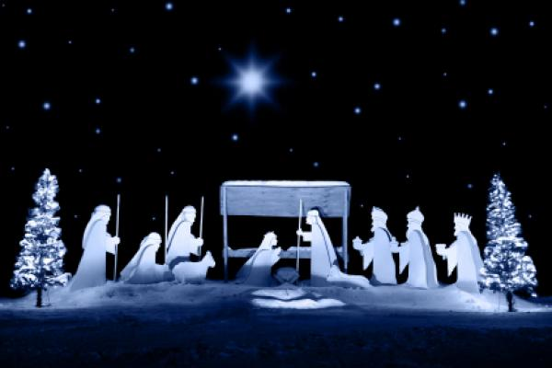
Epiphany
Greek word "epiphaneia" apparition or manifestation
Christian tradition relayed the voyage of the three wise men
to the birthplace
of Jesus.
The three wise men
were named
Balthazar,
Melchior
and Caspar
(known as Gaspard in French).

Slide 6
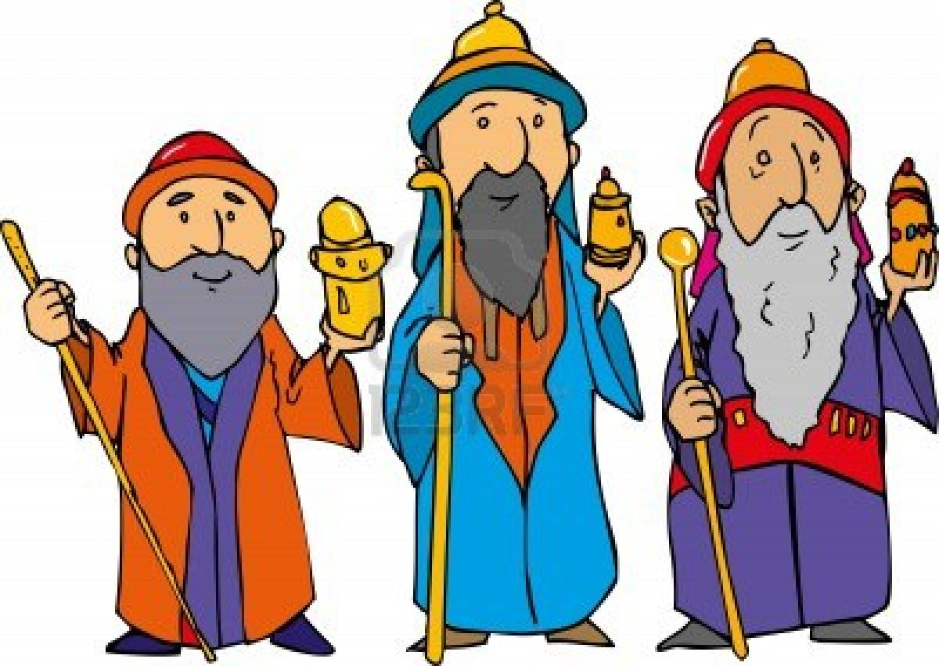
Les Rois
5th century: the wise men became kings “les rois”.
Caspar king of Arabia,
Melchior king of Persia and
Balthazar-king of India.

Slide 7
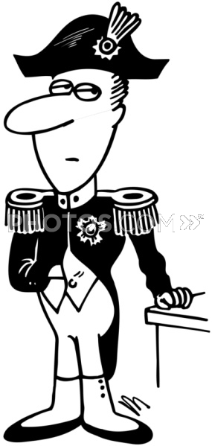
En France- French Concordat
1801: Signed by Napoleon and Pope Pius VII re-establishing the Catholic Church in France.
Epiphany was set on January 6^{th.}
12 days between Christmas Day and
Epiphany represent each month.
Celebrated in song, most notably,
"Twelve Days of Christmas".

Slide 8
En Europe
En Espagne: toys are given to children on this day to symbolize the gifts that the three wise kings gave to Jesus
En Italie: presents are often given on Epiphany as well as on Christmas
En France: families celebrate "La Fête des Rois" with a special cake and the crowning of a king and queen.
The French combined the cake tradition from the Romans and the arrival of the three wise kings in Bethlehem to create a tradition of their own

Slide 9
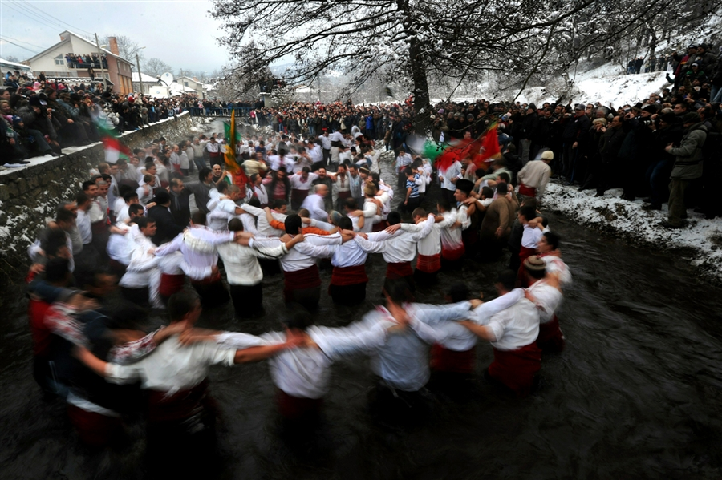
Les Photos

Slide 10
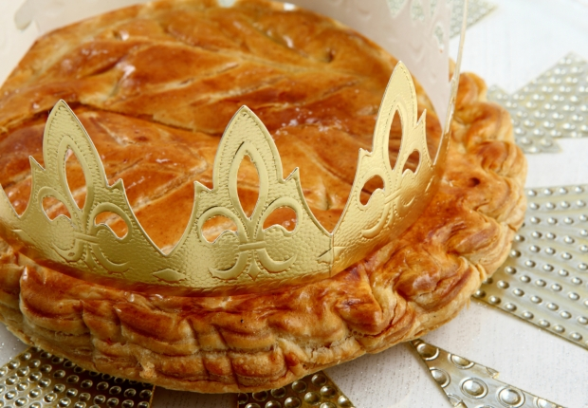
La Galette des Rois
Cake made from puff pastry.
Filled frangipan stuffing almond paste.
South of France galette is simply a brioche
Often served with
candied fruit and
sprinkled with sugar.

Slide 11
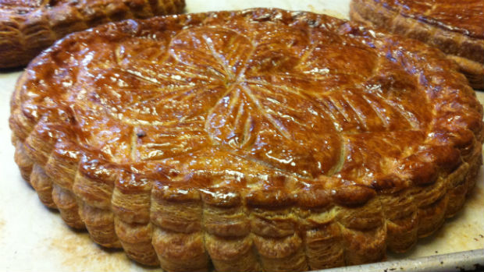
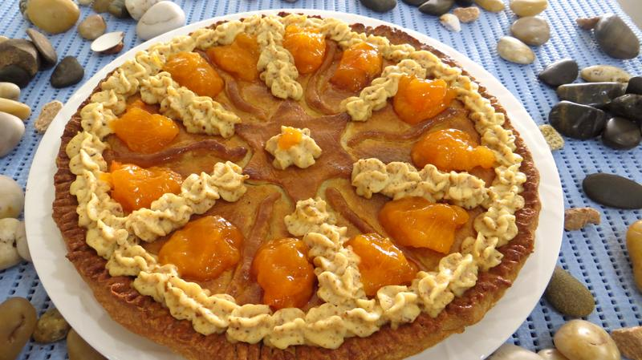
La Galette des Rois
available from the local pâtisserie or grocery store
many French people still bake the cake at home
comes with two crowns for the king and queen of the day
can also purchase la fève from the pastry shop

Slide 12
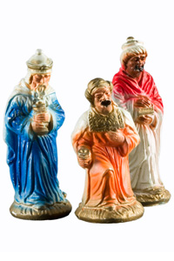
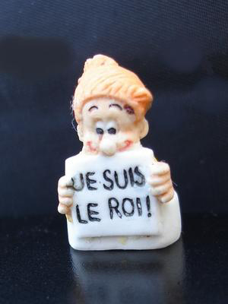
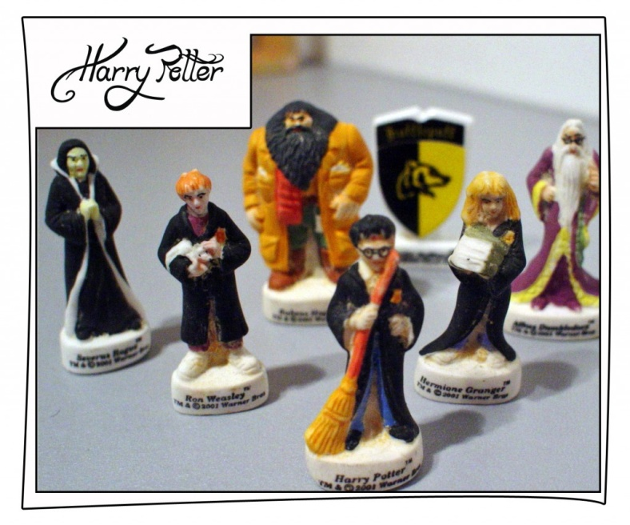
La Fève
Refers to a type of bean.
also the word for the object placed in the galette des rois.
In the French tradition, the fève was a small porcelain piece, often in the shape of a person, that would be placed discreetly in the cake.
traditional theme was to recreate the
nativity scene characters such as baby
Jesus, Mary and Joseph
Historically, the main manufacturer of
fèves was Limoges-Castel which produced
over six million fèves each year.
Now very commercialized in France.

Slide 13
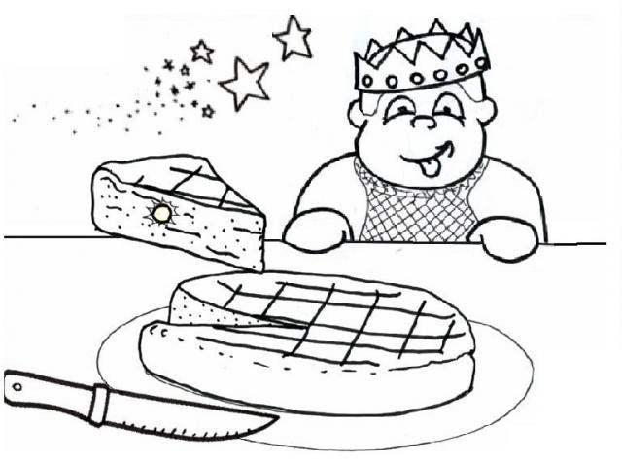
Le Roi et La Reine
The fève is discreetly placed in the galette des rois prior to serving
Cut a piece for everyone present and an extra called la part des pauvres
A symbol for loved ones who are no longer with us and for those who are less fortunate
Nowadays designated for the unexpected visitor and is saved for a later treat.
Traditionally, the youngest family member would slide underneath the table and designate how the slices would be distributed. This prevents cheating since the baker of the cake does not choose
how the slices are handed out
the person who discovered the
fève was king for the day and selected
his queen

Slide 14
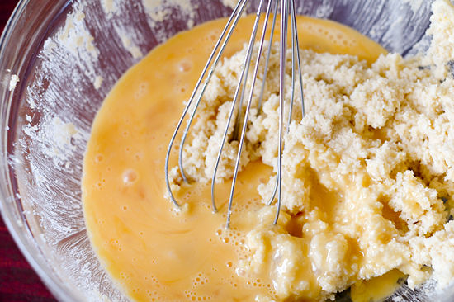
Les Vidéos
How to Make La Galette
Histoire de la Fete des Rois

Slide 15
Vocabulaire
La Galette: Type of cake/brioche normally with an almond filling
Les Saturnales: Roman festival wishing for peace and prosperity
Feuilleté(e): Flakey
Le Gâteau: Cake
Les Rois: Kings
La Fève: a bean or now a figurine hidden inside la galette
Fourré(e): filled
La France: France
La Rêne: Queen
Noël: Christmas
La Fête: Party
Jésus: Jesus
La Couronne: Crown
Les Fabophiles: People who collect les fèves
L’Amande: Almond
La Pâte: Pastry
Limoges-Castel: Famous maker of fèves

